Slide 1
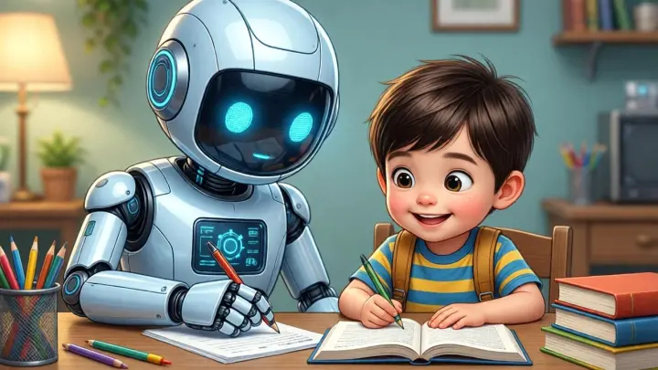
AI tools

Slide 2
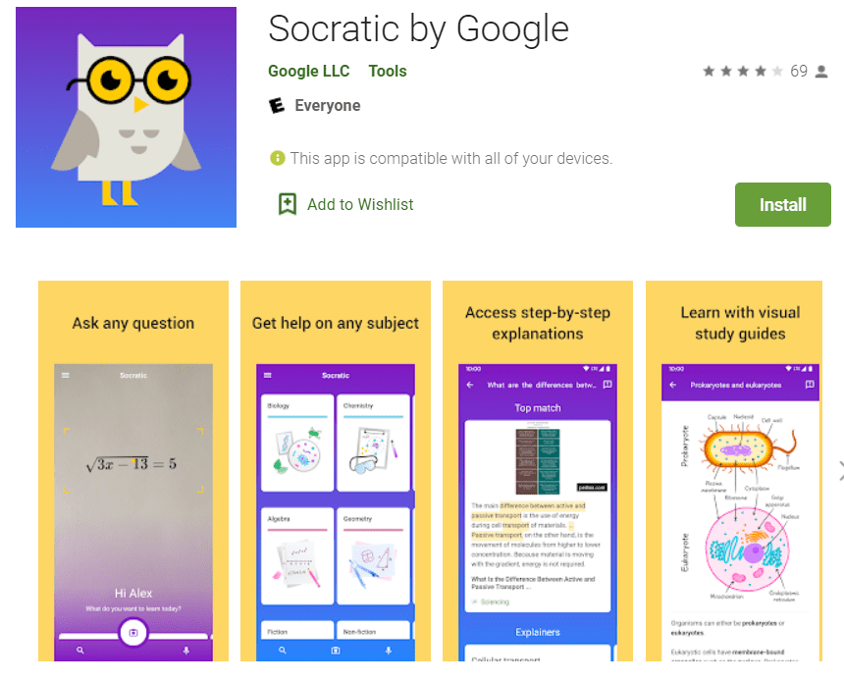
Socratic by Google

Slide 3

https://youtu.be/414ZdWOrcUk?si=GFWhLrz9XB7AkE2N
Stuck on a math problem? Take a photo, and it shows you a step-by-step video and explanation.
https://youtu.be/414ZdWOrcUk?si=GFWhLrz9XB7AkE2N

Slide 4
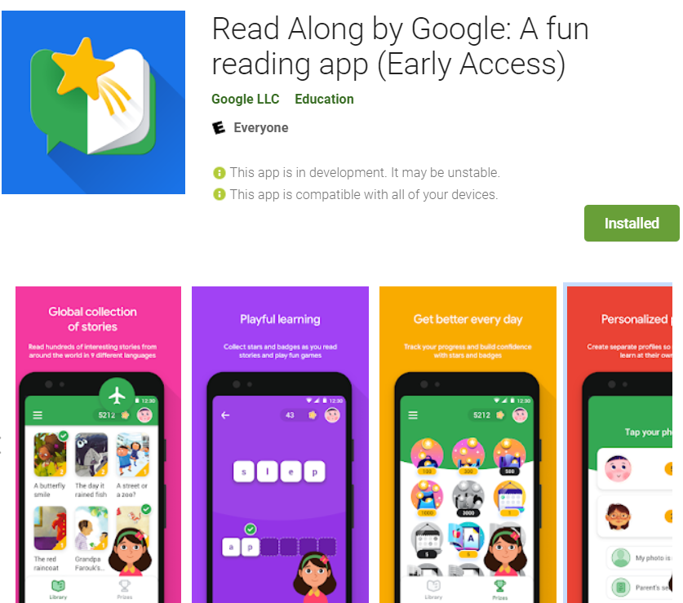
ReadAlong:

Slide 5
https://youtu.be/JQ6A03KQDTc?si=APH8I-ONafkFIQiP
https://youtu.be/JQ6A03KQDTc?si=APH8I-ONafkFIQiP
An AI friend that listens to you read aloud and helps you with tricky words.

Slide 6
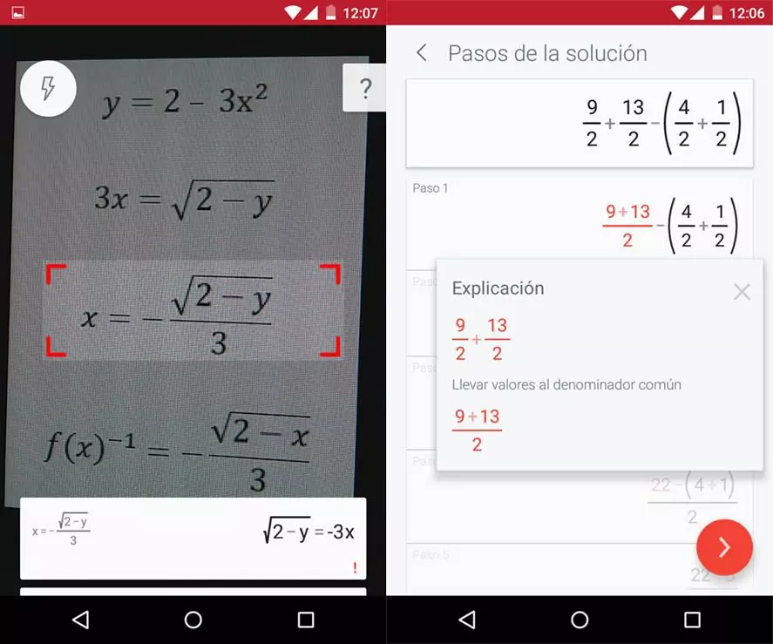
Photomath:

Slide 7
Safe AI Rules for Kids 🛡️
  Remember, AI is a helper, not a shortcut!
  Never give personal info: Don't share your address or real name.
  Check the facts: Sometimes AI "hallucinates" (makes things up), so always double-check with your textbook.
  Do the work: Use AI to explain how to do it, then try it on your own!

